Slide 1
Automated Guided Vehicles (AGV) & Autonomous Mobile Robot (AMR)
Course Code : MCTE 4362
Lecturer : Dr. Zulkifli bin Zainal Abidin
Slide by : Muhammad Iqmal Danish bin Hasnan (1912461)

Slide 2
History of AGV/AMR Robot
This presentation provides an overview of the history of AGV and AMR robots, from their early development up to today’s usage.

Slide 3
AGV
1950s
The first AGV was developed by Barrett Electronics in the United States for use in a grocery store.
1960s-1970s
AGVs were developed for use in factories and warehouses to transport materials and products.
1980s-1990s
AGVs became more advanced and were able to navigate using sensors and computer controls.
Today
AGVs are used in a wide range of industries for material handling and transportation, and can be programmed to perform a variety of tasks.

Slide 4
AMR
2000s
The first AMRs were developed for military and space applications. These early AMRs were used for tasks such as reconnaissance, surveillance, and exploration, and were typically controlled remotely by human operators.
2010s
AMRs began to be used in commercial and industrial settings for tasks such as material handling, inventory management, and cleaning. During this time, advances in sensor technology, artificial intelligence, and machine learning helped to make AMRs more intelligent and autonomous
Today
AMRs are increasingly being adopted in a variety of industries and are becoming more advanced with the integration of artificial intelligence and machine learning capabilities.

Slide 5
Main Components of the Vehicle
Hull Design
Navigation System and Control
Data Transmission
Propulsion System
Data Collection
Power Management

Slide 6
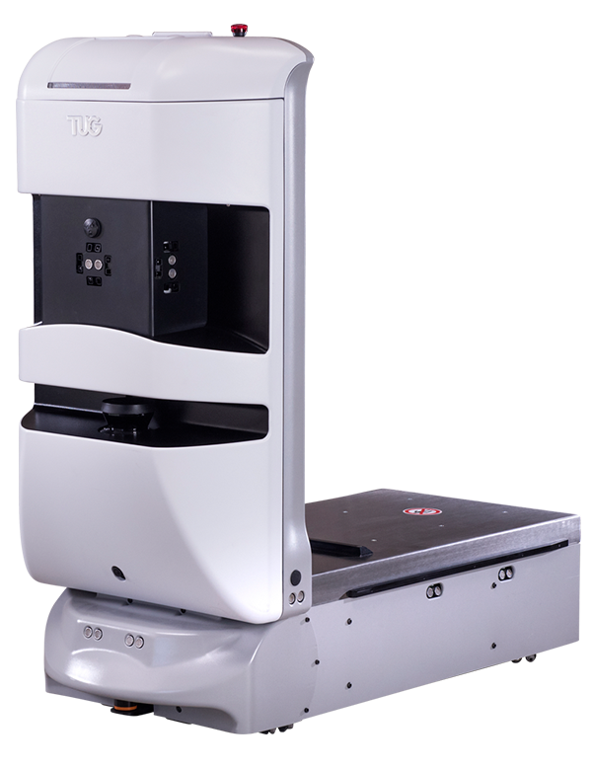
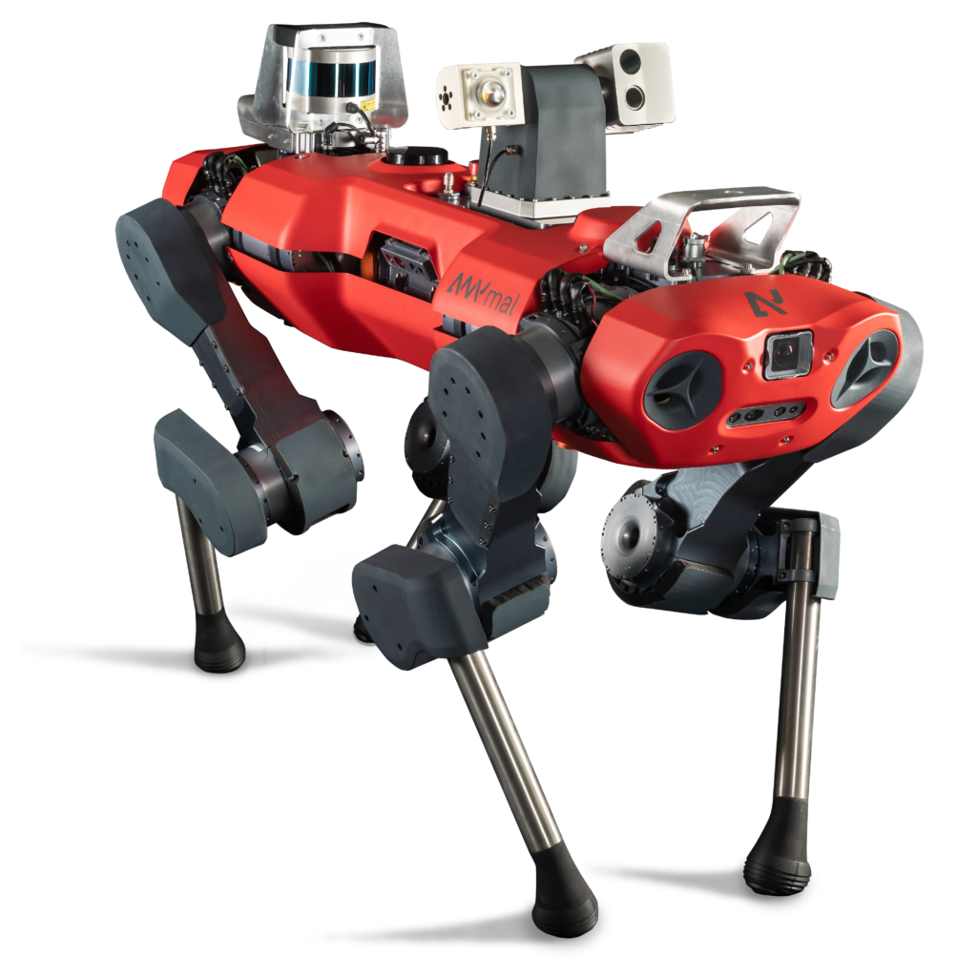
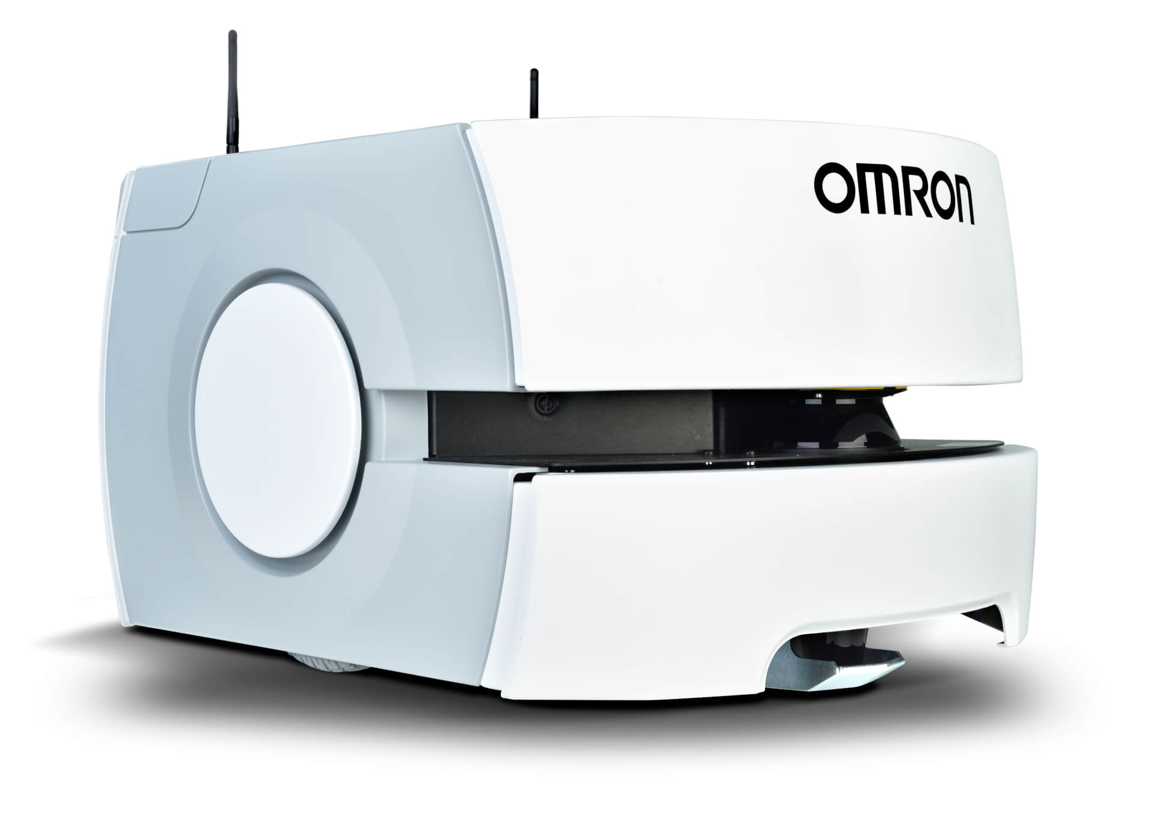
Hull Design
Omron LD robots
Aethon TUG
ANYbotics ANYmal
Holonomic Design
Differential Drive Design
Legged

Slide 7
Hull Design
Type | Holonomic/Omni-directional | Differential drive | Legged
Explanation | These robots have wheels that allow them to move in any direction without changing orientation. This allows them to move and turn quickly and easily. | These robots have two wheels or tracks that can be driven independently, allowing them to turn by driving one wheel faster than the other. This design is simple and reliable. | These robots have legs instead of wheels or tracks, allowing them to navigate difficult terrain and climb over obstacles.
Advantages | Fast and agile movement Can change directions quickly Can move in tight spaces. | Simple and reliable design Good for rough terrain. | Good for rough terrain, can climb over obstacles.
Disadvantages | Less stable than other designs, may have difficulty with steep inclines or rough terrain. | Limited maneuverability, may struggle with tight spaces. | Complex design, slow movement, may struggle with tight spaces.
Applications | Warehouse and logistics, material handling, inspection and maintenance | Supplies/materials transportation | Search and rescue, inspection and maintenance, military
Model | Omron LD robots | Aethon TUG | ANYbotics ANYmal

Slide 8
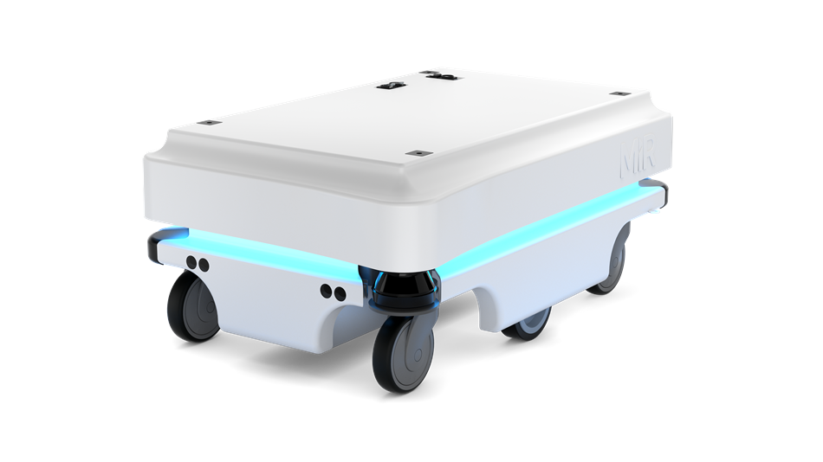
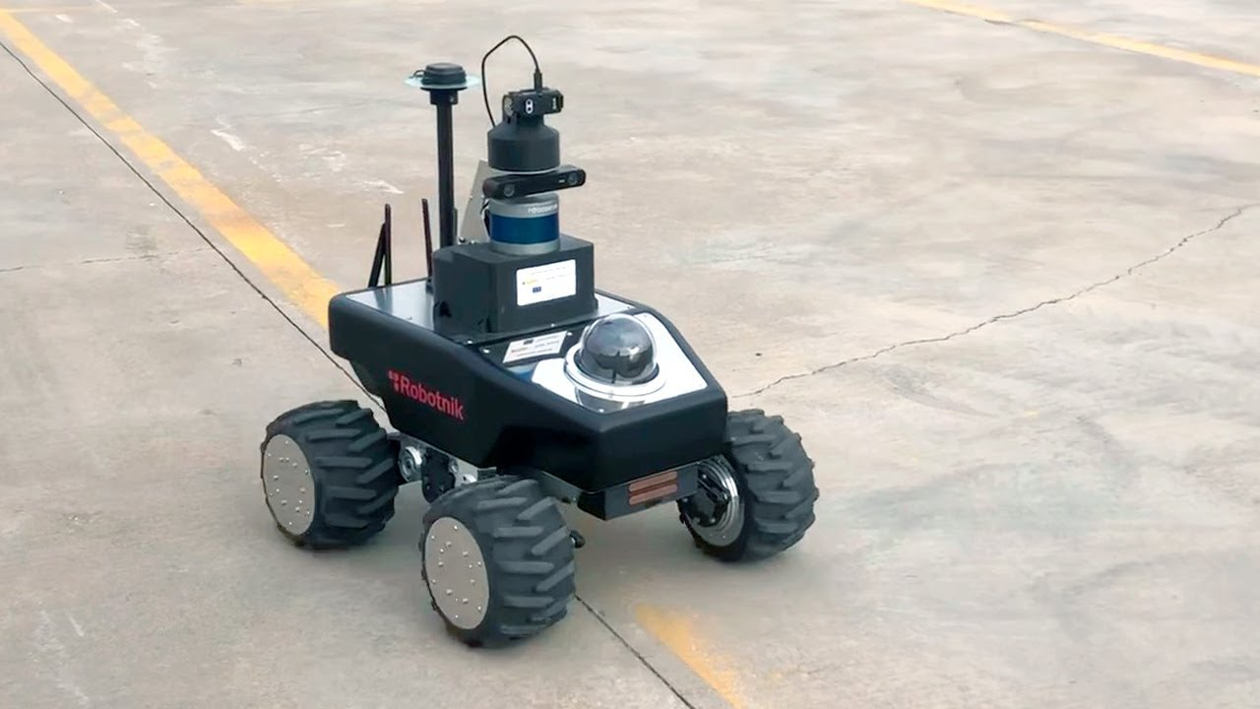
Propulsion System
Mobile Industrial Robots MiR100
Robotnik Summit XL
ANYbotics ANYmal
Wheeled
Tracked
Legged

Slide 9
Propulsion System
Type | Wheeled | Tracked | Legged
Explanation | These robots are propelled by wheels that can be driven independently or together. | These robots are propelled by tracks that can navigate rough terrain and steep inclines. | These robots are propelled by legs, which allow them to navigate rough terrain and climb over obstacles.
Advantages | Simple and reliable design, good for smooth surfaces. | High traction, good for rough terrain and steep inclines. | Can navigate rough terrain and climb over obstacles.
Disadvantages | Limited traction on rough or slippery surfaces. | Slow movement, may struggle with tight spaces. | Complex design, slow movement, may struggle with tight spaces.
Applications | Warehouse and logistics, material handling, indoor environments. | Mining, agriculture, outdoor environments. | Search and rescue, inspection and maintenance, military.
Model | Mobile Industrial Robots MiR100 | Robotnik Summit XL | ANYbotics ANYmal

Slide 10
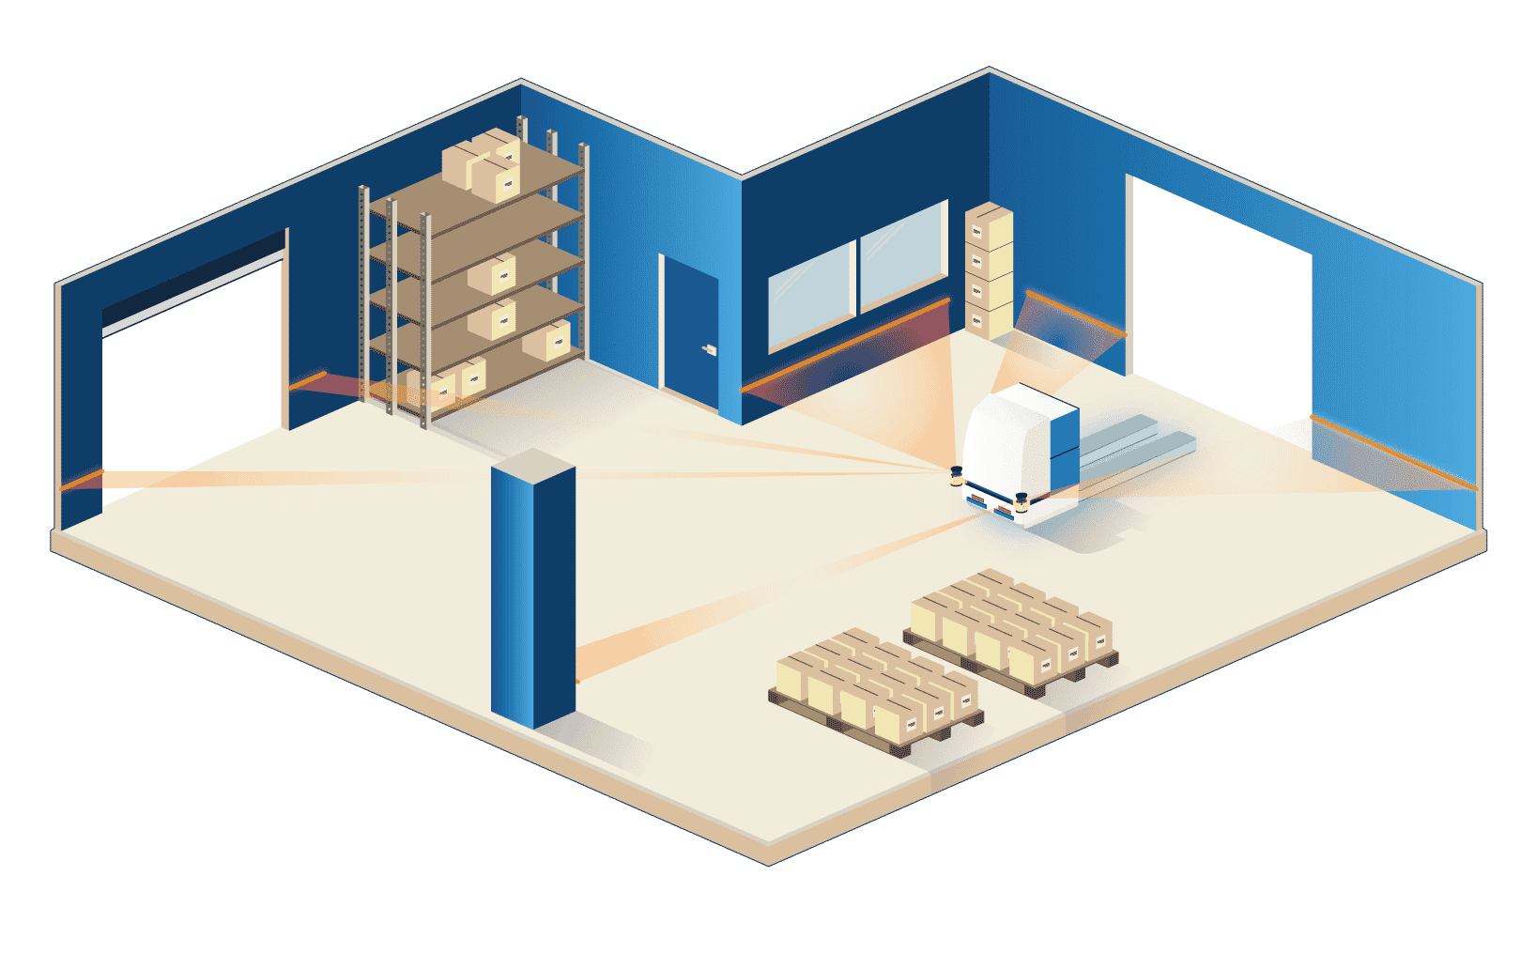
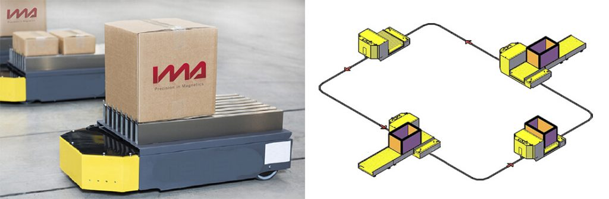
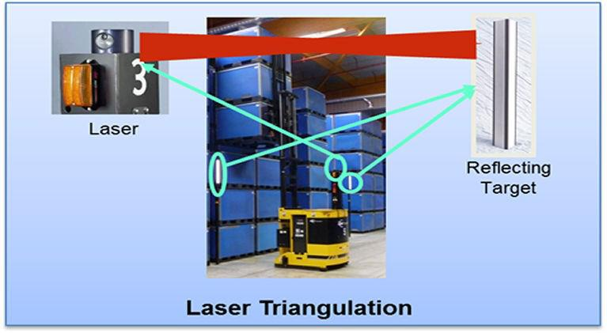
Navigation System & Control
Magnetic tape guidance
Vision guidance
Laser guidance

Slide 11
Navigation System & Control
Type | Magnetic tape guidance | Laser guidance | Vision guidance
Explanation | This system uses a magnetic tape installed on the floor to guide the robot along a predetermined path. | This navigation system uses lasers to scan the environment and build a map of the robot's surroundings. | This navigation system uses cameras or other sensors to detect and analyze the robot's surroundings.
Advantages | Reliable and accurate Low cost. | High accuracy, can adapt to changing environments. | Can adapt to changing environments, can be used in low-light conditions.
Disadvantages | Requires infrastructure (magnetic tapes or markers), limited flexibility in changing routes | Can be expensive, requires a clear line of sight, may not work well in low-light conditions. | Can be affected by poor lighting or visibility, may require significant processing power.
Applications | Manufacturing, assembly lines, material handling. | Warehouses, logistics, material handling. | Inspection and maintenance, cleaning, security.
Model | Kollmorgen AGV | OTTO Motors OMEGA | BlueBotics ANT

Slide 12
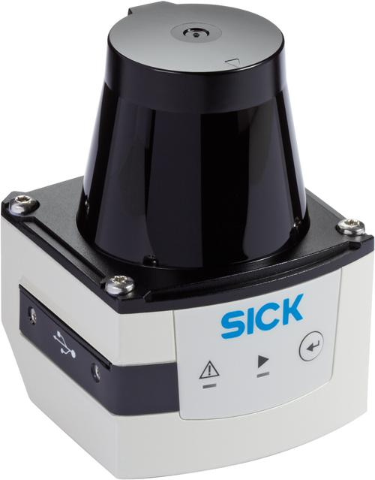
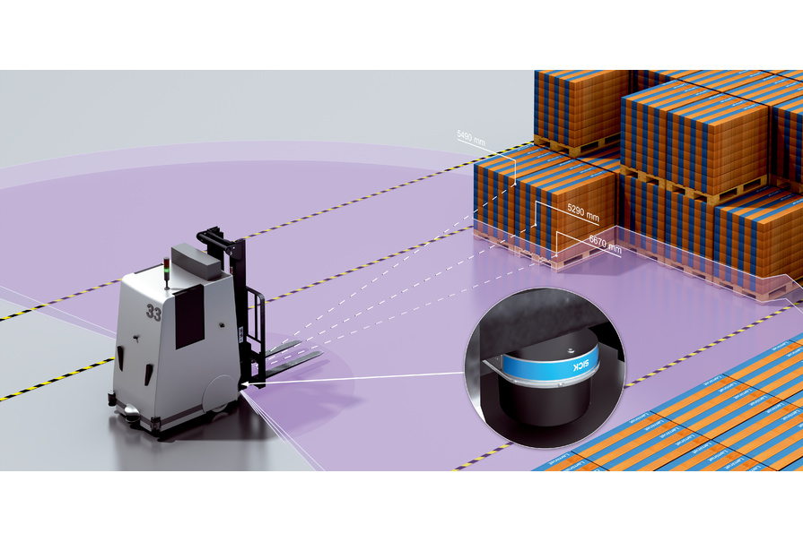
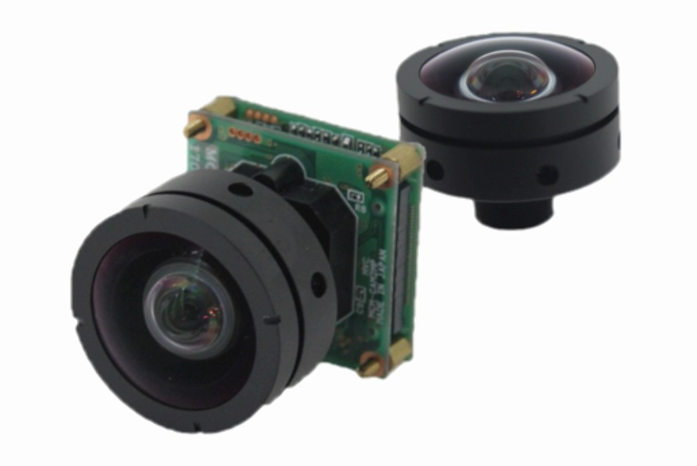
Data Collection (Payload)
Camera
LIDAR
RFID

Slide 13
Data Collection (Payload)
Type | Camera | LIDAR | RFID
Explanation | Cameras can be used to capture images and video of the robot's surroundings, which can be used for navigation, inspection, and security purposes. | LIDAR (Light Detection and Ranging) sensors use lasers to scan the environment and generate a 3D map of the robot's surroundings. This data can be used for navigation and obstacle avoidance. | RFID tags can be attached to objects or locations to track their movement and location. The robot can use RFID readers to collect this data and use it for navigation or inventory management.
Advantages | Can provide high-quality visual data, useful for detecting and identifying objects and hazards. | Provides highly accurate data, can work in low-light conditions. | Easy to install and use, can track objects and locations with high accuracy.
Disadvantages | May be affected by poor lighting or visibility, can require significant processing power. | Can be expensive, may require calibration, limited range. | Requires infrastructure (RFID tags and readers), limited range.
Applications | Inspection and maintenance, security, material handling. | Warehouses, logistics, material handling. | Inventory management, material handling.
Model | MiR500 | Fetch Robotics Freight | Kollmorgen AGV

Slide 14
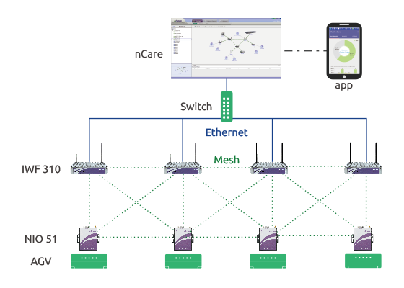
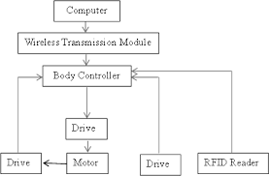

Data Transmission (Communication)
Wi-Fi
Bluetooth
RFID

Slide 15
Data Transmission (Communication)
Type | Wi-Fi | Bluetooth | RFID
Explanation | Wi-Fi is a wireless communication technology that allows robots to connect to a network and transmit data. | Bluetooth is a short-range wireless technology that can be used for communication between robots and other devices. | RFID (Radio Frequency Identification) technology can also be used for communication between robots and other devices, such as tags or readers.
Advantages | Widely available, easy to set up and use. | Easy to set up and use, low power consumption. | Easy to set up and use, can provide real-time data.
Disadvantages | Can be affected by interference and signal strength, may be less secure than other methods. | Limited range, can be affected by interference. | Limited range, can be affected by interference, may require additional infrastructure.
Applications | Warehouses, distribution centers, manufacturing facilities. | Indoor navigation, monitoring and control. | Inventory management, material handling.
Model | Mobile Industrial Robots MiR500 | Aethon TUG | Swisslog CarryPick

Slide 16
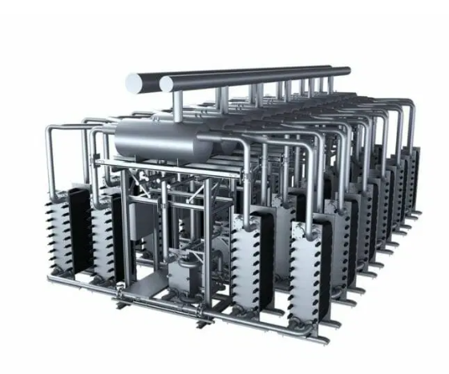
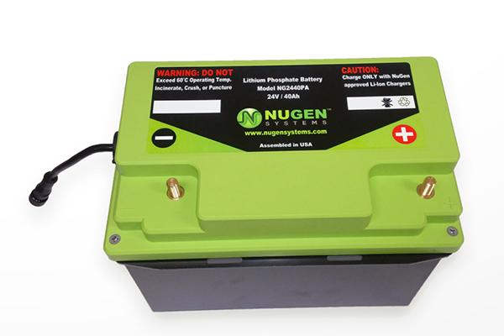
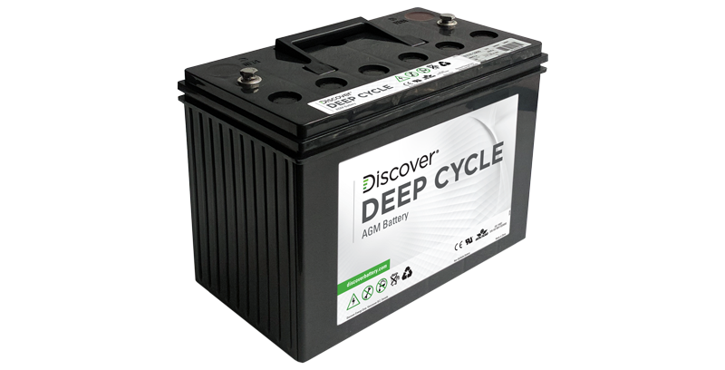
Power Management
Lead Acid Batteries
Hydrogen Fuel Cells
Lithium-Ion Batteries

Slide 17
Power Management
Type | Lead Acid Batteries | Hydrogen Fuel Cells | Lithium-Ion Batteries
Explanation | Lead acid batteries are a type of rechargeable battery that use lead electrodes and sulfuric acid as the electrolyte. | Hydrogen fuel cells use a chemical reaction between hydrogen and oxygen to generate electricity. | Lithium-ion batteries are a type of rechargeable battery that use lithium ions to store and release energy.
Advantages | Low cost, reliable, and widely available. | Zero-emissions, long operating times, and fast refueling. | High energy density, lightweight, long lifespan, no maintenance required.
Disadvantages | Heavy, short lifespan, requires maintenance. | High cost, requires a hydrogen refueling infrastructure. | More expensive than lead-acid batteries.
Applications | Indoor material handling, manufacturing, and warehouse applications. | Indoor and outdoor material handling, manufacturing, and logistics applications. | Indoor and outdoor material handling, healthcare, and logistics applications.
Model | JBT Corporation AGVs | Plug Power ProGen Fuel Cell | Seegrid Palion AGVs

Slide 18
Thank you for your time 😊

